Slide 1


Machine Learning Boot camp (2)
Introduction to Data Science

Slide 2
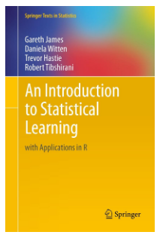
Machine Learning
http://faculty.marshall.usc.edu/gareth-james/ISL/

Slide 3

What is Machine Learning?
Machine learning is essentially a form of applied statistics.
Machine learning is statistics scaled up to big data.
The major difference between machine learning and statistics is their purpose.
Machine learning models are designed to make the most accurate predictions possible. Statistical models are designed for inference about the relationships between variables.
To make this slightly more explicit, there are lots of statistical models that can make predictions, but predictive accuracy is not their strength.
Likewise, machine learning models provide various degrees of interpretability, from the highly interpretable lasso regression to impenetrable neural networks, but they generally sacrifice interpretability for predictive power.

Slide 4
What is Machine Learning?
Using algorithms that iteratively learn from data, machine learning allows computers to find hidden insights without being explicitly programmed where to look.
What is it used for?
● Fraud detection. ● Web search results. ● Real-time ads on web pages ● Credit scoring and next-best offers. ● Prediction of equipment failures. ● New pricing models. ● Network intrusion detection. ● Recommendation Engines ● Customer Segmentation ● Text Sentiment Analysis ● Predicting Customer Churn ● Pattern and image recognition. ● Email spam filtering. ● Financial Modeling.
Artificial intelligence is a bigger concept to create intelligent machines that can simulate human thinking capability and behavior, whereas, machine learning is an application or subset of AI that allows machines to learn from data without being programmed explicitly.

Slide 5
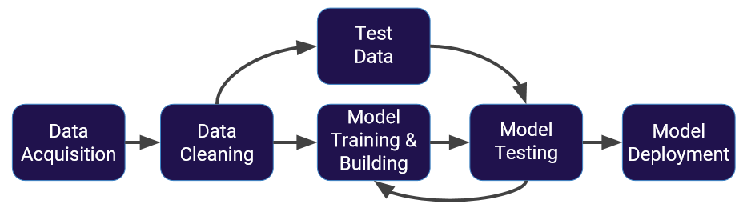
Machine Learning Process

Slide 6
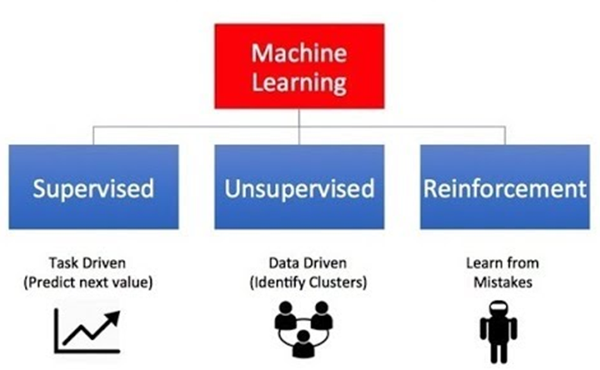
Machine Learning Types

Slide 7
Supervised Learning
Supervised learning algorithms are trained using labeled examples, such as an input where the desired output is known.
For example, a piece of equipment could have data points labeled either “F” (failed) or “R” (runs).
The learning algorithm receives a set of inputs along with the corresponding correct outputs, and the algorithm learns by comparing its actual output with correct outputs to find errors.
It then modifies the model accordingly.
Through methods like classification and regression etc. supervised learning uses patterns to predict the values of the label on additional unlabeled data. Supervised learning is commonly used in applications where historical data predicts likely future events.

Slide 8
Supervised Learning
Supervised learning is commonly used in applications where historical data predicts likely future events.
For example, it can anticipate when credit card transactions are likely to be fraudulent or which insurance customer is likely to file a claim.
Or it can attempt to predict the price of a house based on different features for houses for which we have historical price data.

Slide 9
Unsupervised Learning
Unsupervised learning is used against data that has no historical labels.
The system is not told the "right answer." The algorithm must figure out what is being shown.
The goal is to explore the data and find some structure within.
For example, it can find the main attributes that separate customer segments from each other.
These algorithms are also be used to segment recommend items and identify data outliers
Popular techniques include self-organizing maps, nearest neighbor mapping, k-means clustering and singular value decomposition.

Slide 10
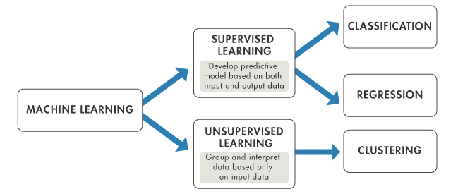
Supervised vs. Unsupervised

Slide 11
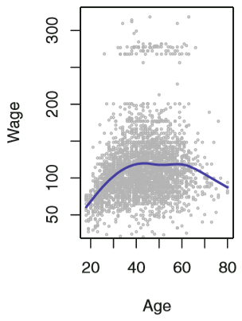
Example 1 – Wage Data
We wish to understand the association between an employee’s age and education, as well as the calendar year, on his wage.
Generally, wage increases with age but decreases after approximately age 60. Given an employee’s age, we can use this curve to predict his wage.
However, it is also clear from the figure that there is a significant amount of variability associated with the average value.
And, so age alone is unlikely to provide an accurate prediction of a particular employee’s wage.

Slide 12
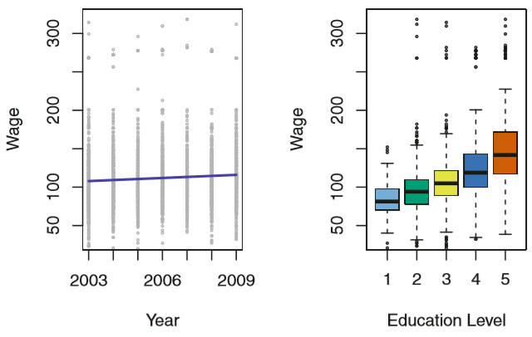
Example 1 – Wage Data
We also have information regarding each employee’s education level and the year in which the wage was earned.
Generally, wages increased by approximately $10,000 in a roughly linear (or straight-line) fashion, between 2003 and 2009. Though this rise is very slight relative to the variability in the data.
Wages are also typically greater for individuals with higher education levels.
Clearly, the most accurate prediction of a given employee’s wage will be obtained by combining his age, education and the year.

Slide 13
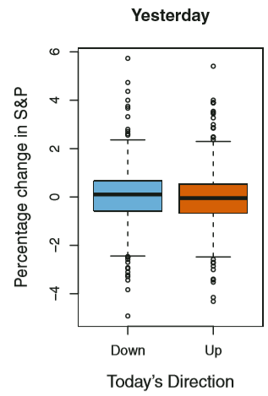
Example 2 – Stock Market Data
The wage data involves a continuous or quantitative output value. This is often referred to as a regression problem.
However, in certain cases we may instead with to predict a non-numerical value – i.e., a categorical or qualitative output.
For example, we examine a stock market data set that contains the daily movements in the Standard & Poor’s 500 stock index over a 5-year period. The goal is to predict whether the index will increase or decrease on a given day – a classification problem.
A model that could accurately predict the direction of the market would be pretty useful!
Figure displays two boxplots of the previous day’s % changes in the stock index. 648 days market up, 602 market down. Almost identical plots, suggesting that there is no simple strategy.

Slide 14
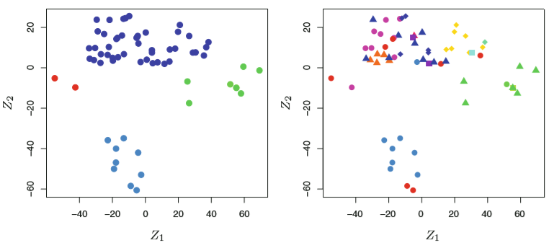
Example 3 – Gene Expression Data
The previous 2 examples illustrate data sets with both input and output variables.
Clustering problem – grouping according to the observed characteristics.
Our goal is to better understand the relationship between gene expression levels and cancer.
We examine observations within each cluster for similarities in their types of cancer.
Left: At least 4 clusters.
Right: Same as left except that the 14 distinct cancer types are shown.

Slide 15

Reinforcement Learning
Reinforcement learning is often used for robotics, gaming and navigation.
With reinforcement learning, the algorithm discovers through trial and error which actions yield the greatest rewards.
This type of learning has three primary components: the agent (the learner or decision maker), the environment (everything the agent interacts with) and actions (what the agent can do).
The objective is for the agent to choose actions that maximize the expected reward over a given amount of time.
The agent will reach the goal much faster by following a good policy. So the goal in reinforcement learning is to learn the best policy.

Slide 16
Supervised Learning

Slide 17
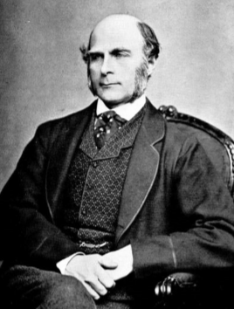
History
This all started in the 1800s with a guy named Francis Galton.
Galton was studying the relationship between parents and their children. In particular, he investigated the relationship between the heights of fathers and their sons.
What he discovered was that a man's son tended to be roughly as tall as his father. However Galton's breakthrough was that the son's height tended to be closer to the overall average height of all people.

Slide 18
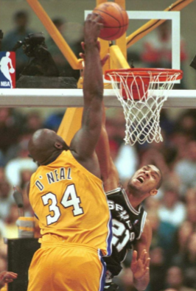
Example
Let's take Shaquille O'Neal as an example.
Shaq is really tall:7ft 1in (2.2 meters). If Shaq has a son, chances are he'll be pretty tall too.
However, Shaq is such an anomaly that there is also a very good chance that his son will be not be as tall as Shaq.
Turns out this is the case: Shaq's son is pretty tall (6 ft 7 in), but not nearly as tall as his dad. Galton called this phenomenon regression, as in
A father's son's height tends to regress (or drift towards) the mean (average) height.

Slide 19
Example
Let's look at another example.
Suppose, we are statistical consultants hired by a client to provide advice on how to improve sales of a particular product.
The Advertising data set consists of sales of the product in 200 different markets, along with advertising budgets in each of these markets for 3 different media: TV, radio and newspaper.
If we determine that there is an association between advertising and sales, then we can advice our client to adjust advertising budgets, thereby indirectly increasing sales.
In other words, our goal is to develop an accurate model that can be used to predict sales on the basis of the 3 media budgets.
The input variables, typically denoted by X, are also referred to as predictors or independent variables. In our case, X1 might be TV budget, X2 the radio budget and X3 the newspaper budget.
The output variable – in this case, sales – is often called the response or dependent variable, typically denoted by Y.

Slide 20
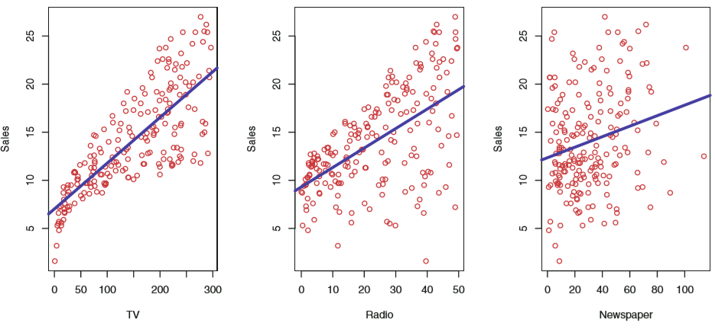
Example

Slide 21
Why Estimate f ?
Our problem now boils down to estimating f, which is some unknown function representing the systematic information that X = (X1, X2, X3) provides about Y, i.e.
Y = f(X) + e where e is a random error term.
Prediction
f is treated as a black box, in the sense that one is not typically concerned with the exact form of f, provided that yields accurate predictions for Y.
Inference
We are often interested in understanding the way that Y is affected as X = (X1, X2, X3) change. Now, f can’t be treated as a black box, because we need to know its exact form.
Which predictors are associated with the response?
What is the relationship between the response and each predictor?
Can the relationship between Y and each predictor be adequately explained using a linear equation, or is the relationship more complex?

Slide 22
Prediction Example
Consider a company that is interested in conducting a direct-marketing campaign.
The goal is to identify individuals who will respond positively to a mailing, based on observations of demographic variables measured on each individual.
In this case, the demographic variables serve as predictors, and response to the marketing campaign (either positive or negative) serves as the outcome.
The company is not interested in obtaining a deep understanding of the relationships between each individual predictor and the response; instead, the company simply wants an accurate model to predict the response using the predictors. This is an example of modeling for prediction.

Slide 23
Inference Example
In contrast, consider the Advertising data discussed in previous slides. One may be interested in answering questions such as:
Which media contribute to sales?
Which media generate the biggest boost in sales?
How much increase in sales is associated with a given increase in TV advertising?
This situation falls into the inference paradigm.

Slide 24
How to Estimate f ?
Parametric methods involve a 2-step model-based approach:
First, we make an assumption about the functional form, or shape, of f. For example, one very simple assumption is that f is linear in X:
f(X) = β0 + β1X1 + β2X2 + ...+ βpXp
This is a linear model, which will be discussed in later slides. Once we have assumed that f is linear, the problem of estimating f is greatly simpliﬁed. One only needs to estimate the p + 1 coeﬃcients β0, β1,...,βp.
After a model has been selected, we need a procedure that uses the training data to ﬁt or train the model. In the case of the linear model ﬁt, we need to estimate the parameters β0, β1,...,βp such that Y ≈ β0 + β1X1 + β2X2 + ...+ βpXp.
The most common approach to ﬁtting the linear model is referred to as least squares, which we discuss later.

Slide 25
How to Estimate f ?
Non-Parametric methods do not make explicit assumptions about the functional form of f. Instead they seek an estimate of f that gets as close to the data points as possible without being too rough or wiggly.
Such approaches can have a major advantage over parametric approaches:
they have the potential to accurately ﬁt a wider range of possible shapes for f.
But non-parametric approaches do suﬀer from a major disadvantage:
since they do not reduce the problem of estimating f to a small number of parameters, a very large number of observations (far more than is typically needed for a parametric approach) is required in order to obtain an accurate estimate for f.

Slide 26
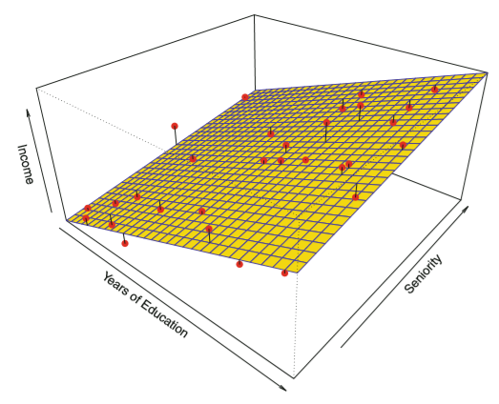
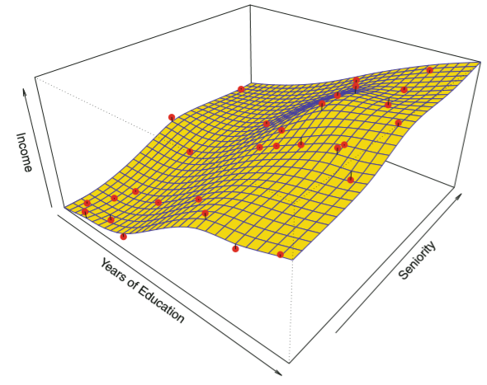
How to Estimate f ?

Slide 27
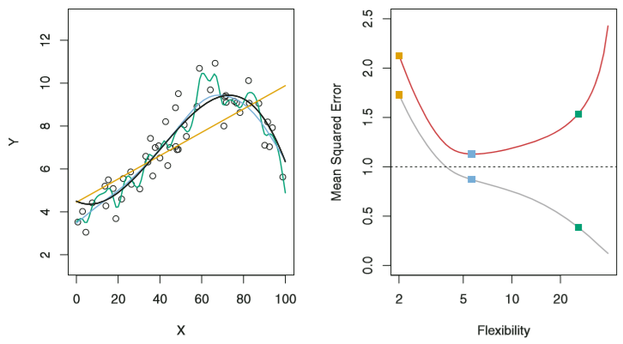
Model Accuracy
There is no free lunch in statistics: no one method dominates all others over all possible data sets. Selecting the best approach can be one of the most challenging parts of performing statistical learning in practice.
Measuring the Quality of Fit: Training and test MSE (mean square of errors)
No guarantee that the method with the lowest training MSE will also have the lowest test MSE.
Increasing flexibility example wrt training data.

Slide 28
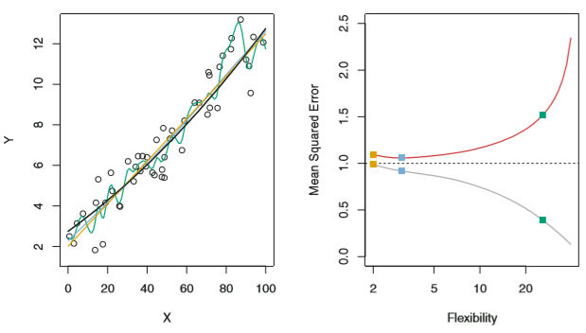
Model Accuracy
Let’s look at another example where f is much closer to being linear. In this setting, linear regression provides a very good fit to the data.
Fundamental property of statistical learning:
Monotone decrease in the training MSE
A U-shape in the test MSE
Overfitting: Small training MSE and large test MSE

Slide 29
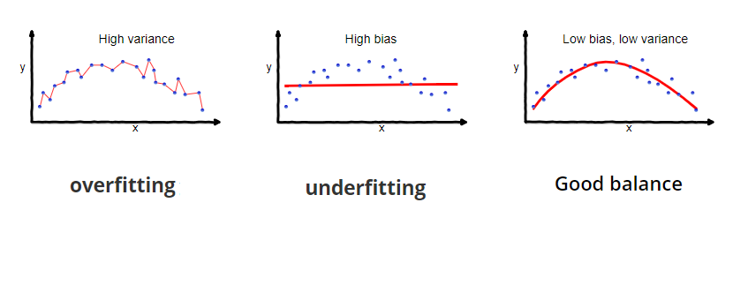
Model Accuracy

Slide 30
Bias-Variance Trade-Off
Two competing properties: We need to select a statistical learning method that simultaneously achieves
Low variance (variance refers to the amount by which f would change if we estimated it using a different training data set. In general, more flexible methods have higher variance.)
Low bias (bias refers to the error that is introduced by approximating a real-life problem, which may be extremely complex, by a much simpler model.)

Slide 31
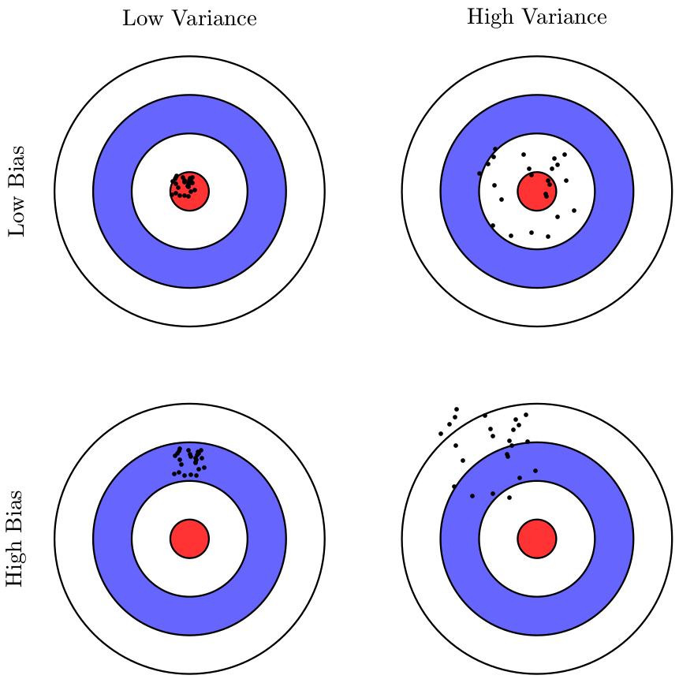
Bull’s Eye Diagram

Slide 32
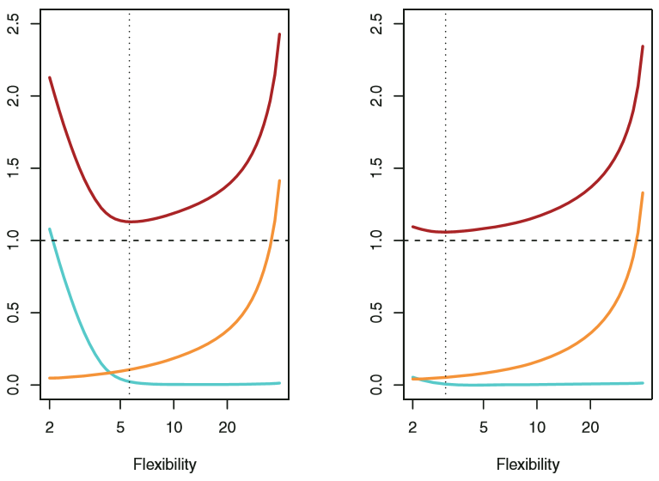
Bias-Variance Trade-Off
Relationship between bias, variance and the test MSE is shown.
Squared bias (blue curve)
Variance (orange curve)
The dashed horizontal line represents the random or irreducible error Var(e).
Test MSE (red curve) is the sum of these 3 quantities.
In both the cases, the variance increases and the bias reduces as the method’s flexibility increases.
Vertical dotted line: Flexibility corresponding to smallest test MSE.

Slide 33
Statistical Learning Exercise

Slide 34
Linear Regression

Slide 35
Summary
Regression problem
Involves predicting a continuous or quantitative output value.
Classification problem
Involves predicting a non-numerical value – that is, a categorical or qualitative output.

Slide 36
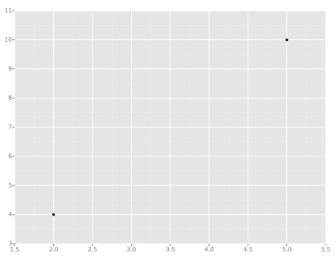
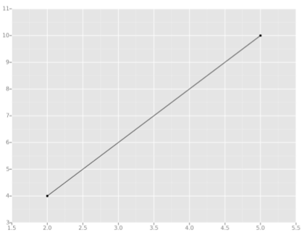
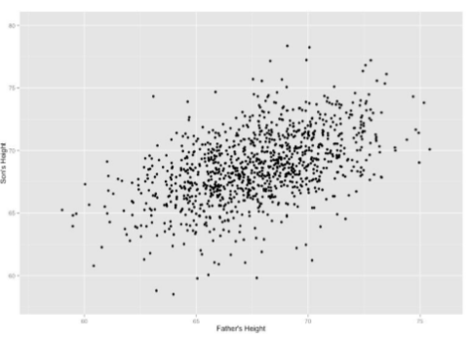
Linear Regression
Let's take the simplest possible example: calculating a regression with only 2 data points.
All we're trying to do when we calculate our regression line is draw a line that's as close to every dot as possible.
Now wouldn't it be great if we could apply this same concept to a graph with more than just two data points?
By doing this, we could take multiple men and their son's heights and do things like tell a man how tall we expect his son to be...before he even has a son!

Slide 37
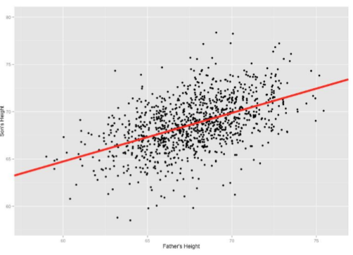
Linear Regression
We can place the line "by eye": try to have the line as close as possible to all points, and a similar number of points above and below the line.
But for better accuracy let's see how to calculate the line using Least Squares method.
Our goal with classic linear regression is to minimize the vertical distance between all the data points and our line. So in determining the best line, we are attempting to minimize the distance between all the points and their distance to our line.

Slide 38
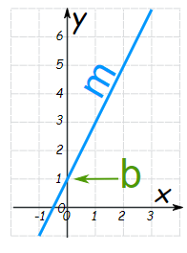

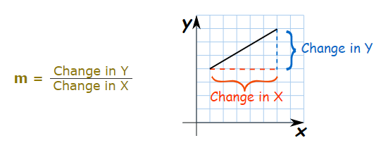
Equation of Line
where
m = Slope or Gradient (how steep the line is)
b = the Y Intercept (where the line crosses the Y axis)
How do you find m?

Slide 39
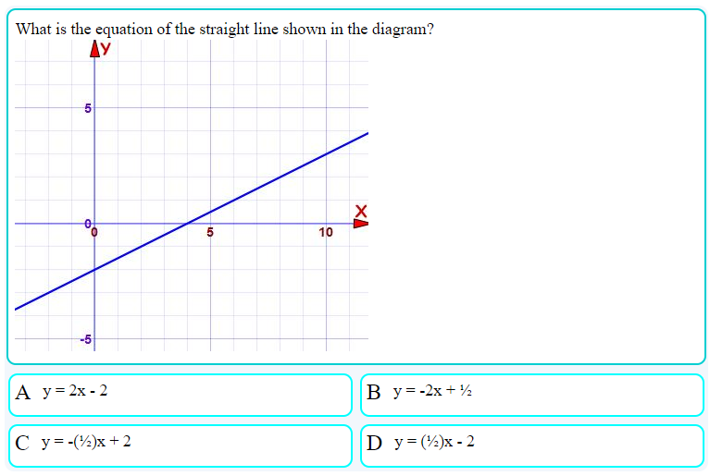
Q1.

Slide 40
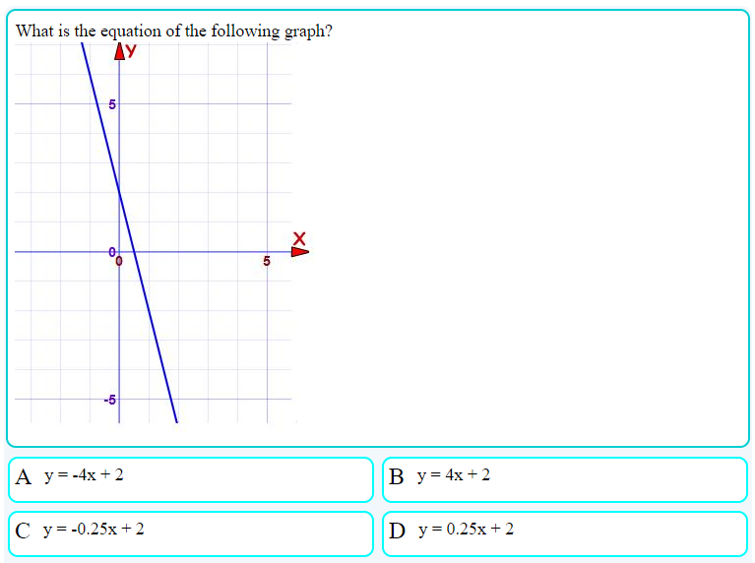
Q2.

Slide 41
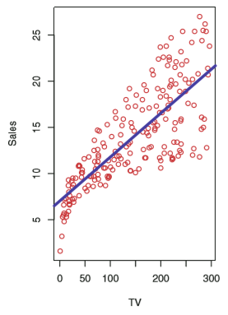
Simple Linear Regression
It is a very straightforward approach for predicting a quantitative response Y on the basis of a single predictor X.
It assumes a linear relationship between X and Y.
Mathematically, we can write
Y = β0 + β1X1
where 2 unknown constants are intercept and slope terms.
We describe the above equation by saying that we are regressing Y onto X.
For example, X may represent TV advertising and Y may represent sales. Then we can regress sales onto TV by fitting the model given by
sales = β0 + β1(TV)

Slide 42
Estimating the Coefficients
How do we estimate the coefficients?
We might have n observation pairs (x1, y1), (x2, y2), … (xn, yn)
We may choose the intercept and the slope values such that the resulting line is as close as possible to the n data points.
There are a number of ways of measuring closeness.
Most common approach involves minimizing the least squares criterion.

Slide 43
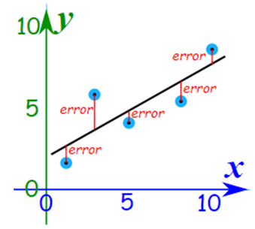
Least Square Fit
How does it work?
It works by making the total of square of errors as small as possible. (which is why it is called least square fit)
The straight line we choose minimizes the sum of squared errors. That is, when the square each of the errors and add them all up, the total is as small as possible.

Slide 44
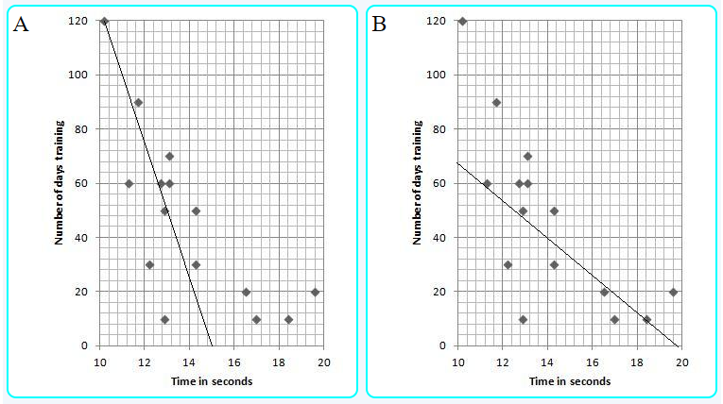
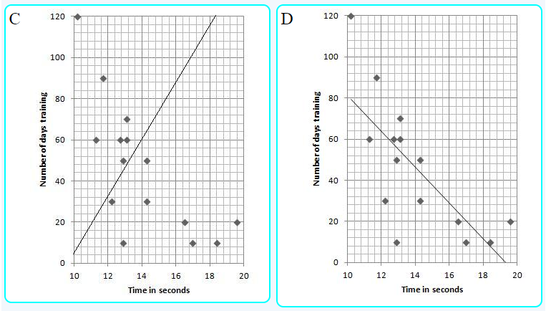
Which graph shows the most accurate “line of best fit” for the scatter plot?
Correlation
When the two sets of data are strongly linked together we say they have a High Correlation.
Correlation is Positive when the values increase together, and it is Negative when one value decreases as the other increases.

Slide 45
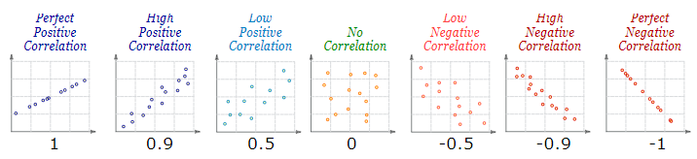
Correlation
Correlation can have a value:
1 is a perfect positive correlation
0 is no correlation (the values don't seem linked at all)
-1 is a perfect negative correlation
The value shows how good the correlation is (not how steep the line is), and if it is positive or negative.

Slide 46
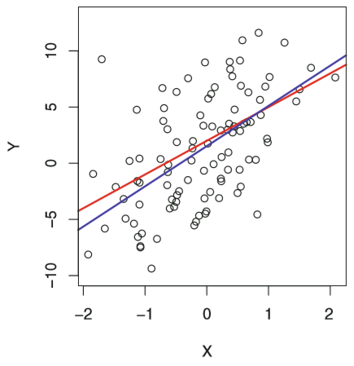
Accuracy of Coefficient Estimates
In real applications, we have access to a limited set of observations from which we compute the least squares line.
However, the true relationship is generally not known for the real data, and the population regression line is unobserved.
Fundamentally, the concept of these two lines is a natural extension of the standard statistical approach of using information from a sample to estimate characteristics of a large population.

Slide 47
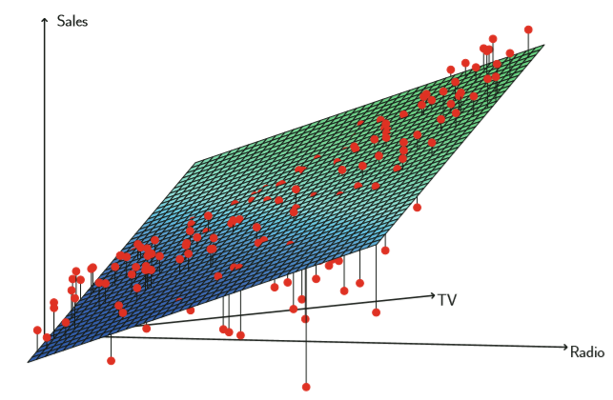
Multiple Linear Regression
Instead of fitting a separate simple linear regression model for each predictor, a better approach is to extend the simple linear regression model so that it can directly accommodate multiple predictors.
We can do this by giving each predictor a separate slope coefficient in a single model.
If we have p predictors, the multiple regression model takes the form
Y = β0 + β1X1 + β2X2 + ...+ βpXp

Slide 48
Some Important Questions
Is at least one of the predictors useful in predicting the response?
Do all the predictors help to explain Y, or is only a subset of the predictors useful?
Forward selection is a greedy approach.
We begin with a null model – a model that contains an intercept but no predictors.
We then fit p simple linear regressions and add to the null model the one resulting in lowest square of errors.
We continue like this until some stopping rule is satisfied.
Backward selection
Mixed selection
How well does the model fit the data?
Given a set of predictor values, how accurate is our prediction?

Slide 49
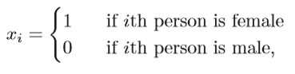
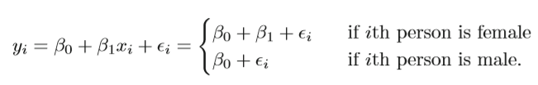
Other Considerations
Qualitative Predictors
So far, we assumed that all variables are quantitative. But in practice, often some predictors are qualitative.
For example, suppose we wish to investigate the differences in credit card balance between males and females. We may create a dummy variable based on the gender variable of the form
and use this variable as a predictor in the regression equation. This results in the model
Qualitative predictors with more than 2 levels?

Slide 50
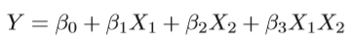
Other Considerations
Additive Assumption
For example, in our previous analysis of Advertising data, the linear models assumed that effect on sales of increasing one advertising medium is independent of the amount spent on the other media.
However, there may be some synergy effect or an interaction effect.
One way of introducing an interaction term to allow for interaction effects between X1 and X2 is by computing the product of X1.X2

Slide 51
Regression Exercise

Slide 52
Classification Problem

Slide 53
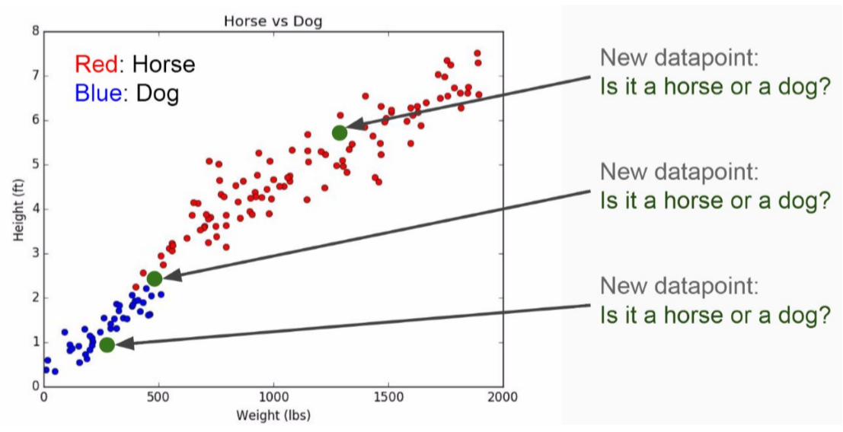
Example
Imagine we had some imaginary data on Dogs and Horses, with heights and weights.

Slide 54
Good Classifier
So far, the model accuracy was focused on the regression setting.
Many of the concepts such as bias-variance trade-off also transfer to the classification setting with small modifications.
Due to the fact that Y is no longer numerical.
The most common approach for quantifying the accuracy of our estimate f is the training or the test error rate, the proportion of mistakes that are made if we apply our estimate f to the training/test observations.
Good classifier = small test error rate

Slide 55
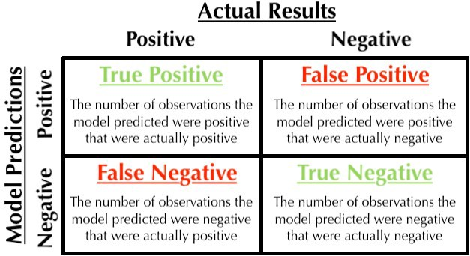
Good Classifier – Test Error Rate
Confusion Matrix
A convenient way to display the information
Two kinds of error rate
Sensitivity
Specificity

Slide 56
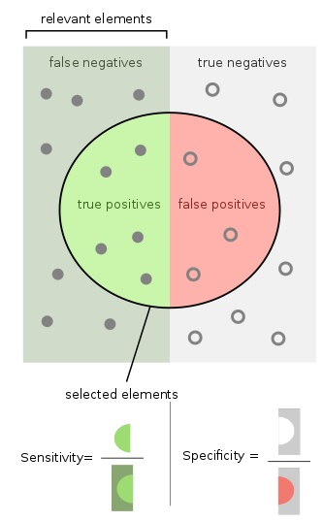
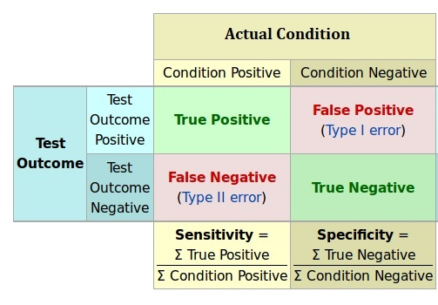
Example
COVID-19 Test Kit from China
Common Cold – Medicine?

Slide 57
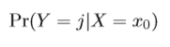
Bayes Classifier
It can be shown that the test error rate is minimized, on average, by a very simple classifier that assigns each observation to the most likely class, given its predictor values.
It is the conditional probability that Y = j, given the observed predictor vector X = x0.
This simple classifier is called the Bayes classifier.

Slide 58
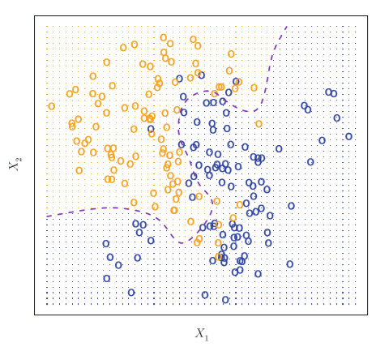
Bayes Classifier
In a 2-class problem, there are two possible response values.
The Bayes classifier corresponds to predicting class 1 if Pr(Y = 1|X = x0) > 0.5 and class 2 otherwise.
For example,
100 observations in each of the 2 groups
Dashed line represents the Bayes boundary
Finite Bayes error rate

Slide 59
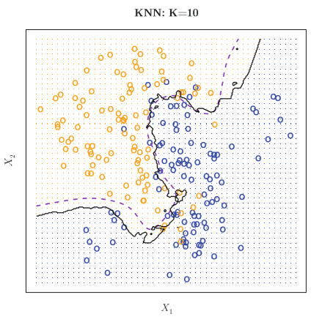
K-Nearest Neighbors
Bayes classifier is the unattainable gold standard against which to compare other methods such as K-nearest neighbors (KNN) classifier.
Given a positive integer K and a test observation x0, the KNN classifier first identifies K points in the training data that are closest to x0.
It then estimates the conditional probability Pr(Y = j|X = x0).

Slide 60
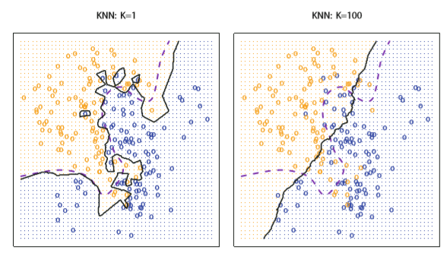
K-Nearest Neigbors
The choice of K has a drastic effect on the KNN classifier obtained.
For example, for K = 1, the decision boundary is overly flexible, while with K = 100 it is not sufficiently flexible.

Slide 61
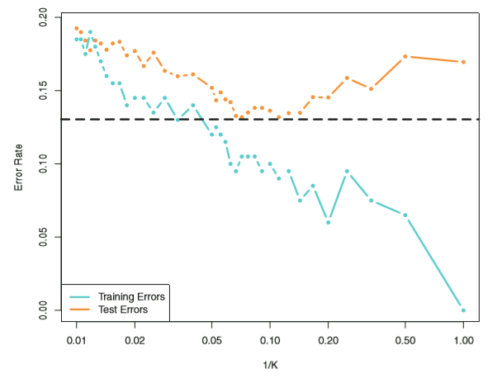
K-Nearest Neigbors
As 1/K increases, the method becomes more flexible.
As in the regression setting, the training error rate consistently declines as the flexibility increases. However, the test error exhibits a characteristic U-shape.

Slide 62
Classification Exercise

Slide 63
K-Nearest Neighbors Regression
Linear regression is an example of a parametric approach because it assumes a linear functional form for f(X).
The simplest and best-known non-parametric method is the KNN regression, which is closely related to the KNN classifier.
For an observation x0, it estimates f(x0) using the average of all the training responses that are closest to x0.
In what setting will a parametric approach such as least squares linear regression outperform a non-parametric approach such as KNN regression?
If the parametric form selected is close to the true form of f.
In higher dimensions, KNN often performs worse than linear regression.
Curse of dimensionality.

Slide 64
Tree-Based Methods

Slide 65
Example
Let’s start off with a thought experiment to give some motivation behind using a decision tree.
Imagine that you play Tennis every Saturday and you always invite a friend to come with you.
Sometimes your friend shows up, sometimes not.
For him it depends on a variety of factors, such as: weather, temperature, humidity, wind etc..
You start keeping track of these features and whether or not he showed up to play.

Slide 66
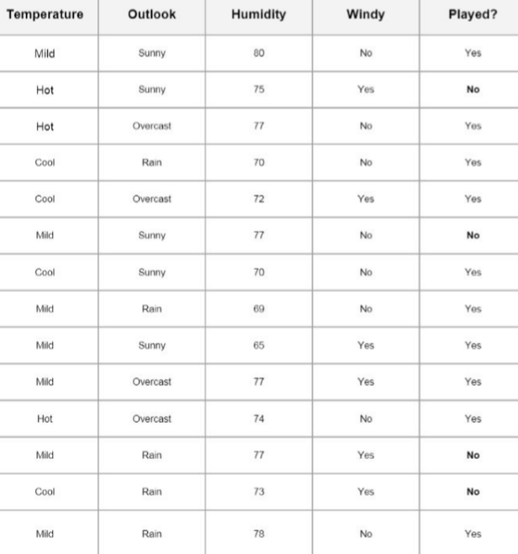

Slide 67
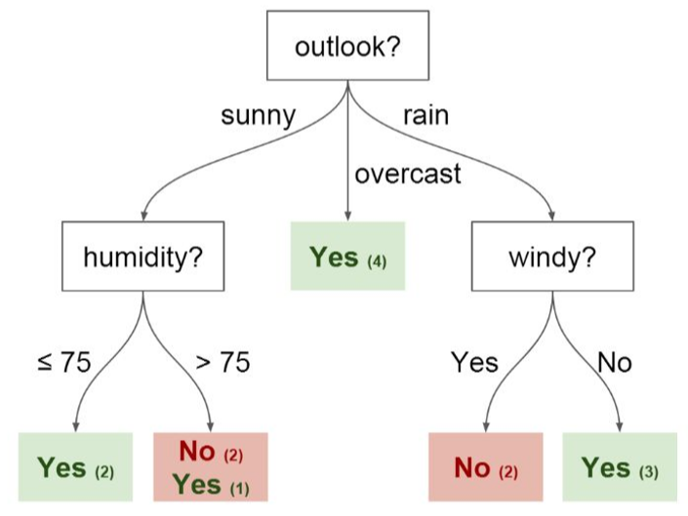
Example
Let us use this data to predict whether or not he will show up to play.
An intuitive way to do this is through a Decision Tree.
In this tree we have:
Nodes, which are split for the value of a certain attribute
Edges
Root – the first node
Leaves, which are the terminal nodes that predict the outcome

Slide 68
Decision Trees
These involve segmenting the predictor space into a number of simple regions.
Since, the set of splitting rules used to segment the predictor space can be summarized in a tree, these type of approaches are known as decision tree methods.
Decision trees can be applied to both regression and classification problems.

Slide 69
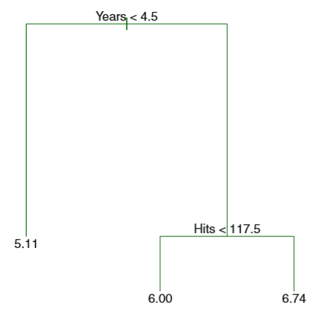
Regression Trees
Let us begin with a simple example:
Predicting baseball players’ salaries using regression trees
We use Hitters data set to predict a baseball player’s Salary (in thousands of $) based on Years (the number of years that he has played in the leagues) and Hits (number of hits that he made in the previous year).
Top split assigns observations having Years < 4.5 to the left branch.
The predicted salary for these players is given by the mean response value for the players in the data set with Years < 4.5.

Slide 70
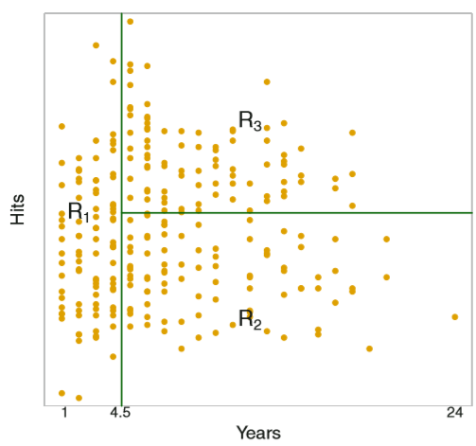
Regression Tree Example
Overall, the tree stratifies or segments the players into 3 regions of predictor space:
Players who have played for 4 or fewer years
Players who have played for 5 or more years and make fewer than 118 hits last year
Players who have played for 5 or more years and make at least 118 hits last year
Tree analogy – the 3 regions are known as terminal nodes or leaves of the tree.

Slide 71
Regression Trees
Advantages and disadvantages:
Over-simplification of the true relationship between Hits, Years and Salary. Lack of predictive accuracy.
Easier to interpret
Nice graphical representation
Computationally infeasible to consider every possible partition of the feature space.
We take a top-down, greedy approach known as recursive binary splitting.
Begins at the top of the tree
Successively splits the predictor space
Each split into two branches further down the tree
At each step, the best split is made, rather than looking ahead

Slide 72
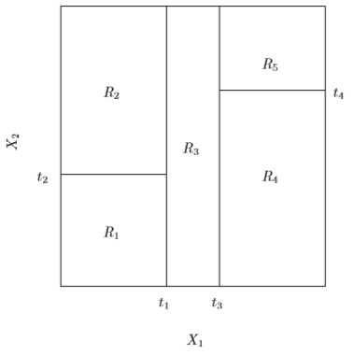

Recursive Binary Splitting
Can the partition of two-dimensional feature space shown be a result from recursive binary splitting?

Slide 73

Recursive Binary Splitting
Can the partition of two-dimensional feature space shown on the right be a result from recursive binary splitting?

Slide 74


Slide 75
Tree Pruning
One strategy is to build the tree only so long as the decrease in the RSS due to each split exceeds some threshold.
Smaller trees
Short-sighted – ? seemingly worthless split early on followed by a very good split
Grow a large tree and then prune it, to obtain a subtree
Goal is to lower the test error rate
Many possible subtrees
Cost complexity or weakest link pruning where we consider only a sequence of subtrees

Slide 76
Classification Trees
Classification tree is similar to a regression tree, except that it is used to predict a qualitative response rather than a quantitative one.
Just as in the regression setting, we can use recursive binary splitting to grow a classification tree.
RSS cannot be used as a criterion for making the binary splits.
Classification error rate
Gini index – a measure of node purity (a small value indicates that a node contains predominantly observations from a single class)
Cross-entropy – used to evaluate the quality of a particular split

Slide 77
Bagging
Decision Trees Review:
Easier to explain to people…definitely easier than linear regression!
Graphical representation and easy to interpret even by a non-expert.
Can handle qualitative predictors without the need to create dummy variables.
Unfortunately, trees generally lack predictive accuracy as compared to other regression and classification approaches.
By aggregating many decision trees, using methods like bagging, random forests and boosting, the predictive performance of trees can be substantially improved.
Bootstrap aggregation or boosting is a general purpose procedure to reduce the variance of a statistical learning method.
And average all the predictions from B different trees.
We generally do not have access to multiple training sets. We generate B different bootstrapped training data sets.

Slide 78
Bagging
Bagging review:
Typically results in improved accuracy over prediction using a single tree.
It is no longer clear which variables are most important to the procedure. Thus, bagging improves prediction accuracy at the expense interpretability.
The predictions from the bagged trees is highly correlated.
Suppose that there is one very strong predictor.
Then in the collection of bagged trees, most or all of the trees will use this strong predictor in the top split.
Consequently, all of the bagged trees will be highly correlated.
Hence, the predictions from the bagged trees will be highly correlated.
Why is it a problem?
Averaging many highly correlated quantities does not lead to a large reduction in variance as averaging many uncorrelated quantities.

Slide 79
Random Forests
As bagging, we build a number of decision trees on bootstrapped training samples.
Random forests overcome the bagging problem by forcing each split to consider only a random subset of the predictors.
The main difference between bagging and random forests is the choice of predictor subset size m.
Typically, m is chosen to be the square root of p, the number of predictors.
By randomly leaving out candidate features from each split, random forests decorrelates the trees, such that the averaging process can reduce the variance of the resulting model.

Slide 80

Random Forests
Dashed line indicates the test error resulting from a single tree.
Test error as a function of B, the number of bootstrapped training sets.
OOB (Out-of-bag) error

Slide 81
Boosting
Trees are grown sequentially
Each tree is grown using information from previously grown trees.
Slow learning method
In general, statistical learning approaches that learn slowly tend to perform well.

Slide 82
Decision Trees Exercise

Slide 83
Unsupervised Learning

Slide 84
Unsupervised Learning
Supervised learning is a well-understood area.
In unsupervised learning, we only have a set of features X = (X1, X2,…, Xp) measured on n observations. We are not interested in prediction, because we do not have an associated response variable Y.
Rather, the goal is to discover interesting things about the measurements on X = (X1, X2,…, Xp)
Clustering, a broad class of methods is used for discovering unknown subgroups in data.
Unsupervised learning is often performed as part of an exploratory data analysis.
It is hard to access the results obtained from unsupervised learning methods.
Examples:
Online shopping site might try to identify groups of shoppers with similar browsing and purchase histories, as well as preferences of shoppers within each group.
Search engine – search results based on click history

Slide 85

Clustering Methods
When we cluster the observations of a data set, we seek to partition them into distinct groups so that
the observations within each group are quite similar to each other,
while observations in different groups are quite different from each other.
We must define similar and different.
Two best-known clustering approaches:
K-means clustering
Hierarchical clustering

Slide 86

K-Means Clustering
The K-Means Algorithm
Choose a number of Clusters K. For example K = 3.
Randomly assign each point to a cluster
Until clusters stop changing, repeat the following:
For each cluster, compute the cluster centroid.
Assign each data point to the cluster for which the centroid is the closest.

Slide 87

K-Means Clustering
With K = 3
Step 1: Each observation is randomly assigned to a cluster.
Step 2a: Cluster centroids are computed. Initially, they are almost overlapping.
Step 2b: Each observation is assigned to the nearest centroid.
Step 2a (iteration 2) leads to new clusters.
The results obtained after 10 iterations.

Slide 88

Choosing a K Value

Slide 89
Choosing a K Value
There is no easy answer for choosing a “best” K value.
One way is the elbow method
First of all, compute the sum of squared error (SSE) for some values of K (for example 2, 4, 6, 8, etc.). The SSE is defined as the sum of the squared distance between each member of the cluster and its centroid.
If you plot K against the SSE, you will see that the error decreases as K gets larger; this is because when the number of clusters increases, they should be smaller, so distortion is also smaller.
The idea of the elbow method is to choose the K at which the SSE decreases abruptly.

Slide 90

Choosing a K Value
Elbow method

Slide 91
K-Means Clustering Exercise

Slide 92

Hierarchical Clustering
Attractive tree-based representation of the observations, called a dendrogram.

Slide 93
Hierarchical Clustering
Bottom-up clustering
The dendrogram (generally depicted as an upside-down tree) is built starting from leaves and combining clusters up the trunk.
The earlier (lower in the tree) fusion occurs, the more similar the groups of observations are to each other.
On the other hand, observations that fuse later (near the top of the tree) can be quite different.

Slide 94

Dendrogram Example 1
Observations 5 & 7 are similar, as are observations 1 & 6.
Observations 2, 8, 5 & 7 all fuse with observation 9 at the same height.
Therefore, observation 9 is no more similar to observation 2 than it is to observations 8, 5 & 7.
Even though, 9 & 2 are close together in terms of horizontal distance.

Slide 95

Dendrogram Example 2
Number of Clusters
Height of the cut to the dendrogram serves the same role as the K in K-means clustering. It controls the number of clusters obtained.

Slide 96

Hierarchical Clustering
Algorithm
Initially, treat each observation as its own cluster.
Compute/measure pairwise inter-cluster dissimilarities.
Examine all pairwise inter-cluster dissimilarities and identify the pair of clusters that are most similar. Fuse them together in a single cluster.
Repeat.

Slide 97

Choice of Dissimilarity Measure
Type of data should determine the dissimilarity measure.
For example, consider an online retailer interested in clustering shoppers based on their past shopping histories.
The goal is to identify subgroups of similar shoppers.

Slide 98
Hierarchical Clustering Exercise

Slide 99


Which Dendrogram?

Slide 100

Which Dendrogram?

Slide 101
Summary
What is data science?
Data types – Vectors, matrices and data frames
Programming in R
R Packages:
Dplyr for data manipulation
Tidyr for data cleaning
Ggplot2 and Plotly for data visualization
What is machine learning?
Regression problem – linear regression, regression trees
Classification problem – KNN classifier, classification trees
Unsupervised learning – K-Means and hierarchical clustering

Slide 102
Reinforcement Learning

Slide 103

Neural Networks
Neural networks are modeled after biological neural networks and attempt to allow computers to learn in a similar manner to humans - reinforcement learning.
The human brain has interconnected neurons with dendrites that receive inputs, and then based on those inputs, produce an electrical signal output through the axon.

Slide 104

Perceptron
Let’s start by looking at the simplest Neural network possible - the perceptron.
A perceptron consists of one or more inputs, a processor, and a single output.
Each input that is sent into the neuron must first be weighted, i.e. multiplied by some value.
The output of a perceptron is generated by passing that sum through an activation function (Logistic, Trigonometric, Step, etc…). In the case of a simple binary output, the activation function is what tells the perceptron whether to “fire” or not.

Slide 105
Perceptron
To actually train the perceptron we use the following steps:
Provide the perceptron with inputs for which there is a known answer.
Ask the perceptron to guess an answer.
Compute the error. (How far off from the correct answer?)
Adjust all the weights according to the error.
Return to Step 1 and repeat!
We repeat this until we reach an error we are satisfied with (we set this before hand).
That is how a single perceptron would work. Now, to create a neural network all you have to do is link many perceptrons together in layers!

Slide 106

Neural Networks
You’ll have an input layer and an output layer.
Any layers in between are known as hidden layers, because you don’t directly “see” anything but the input or output.

Slide 107

Neural Networks
You may have heard of the term Deep Learning. That’s just a Neural Network with many hidden layers, causing it to be “deep”. For example, Microsoft’s state of the art vision recognition uses 152 layers.

Slide 108



